Slide 1
COMP6940: BIG DATA AND DATA VISUALISATION
LECTURE #1: COURSE INTRODUCTION AND OVERVIEW
Inzamam Rahaman

Slide 2
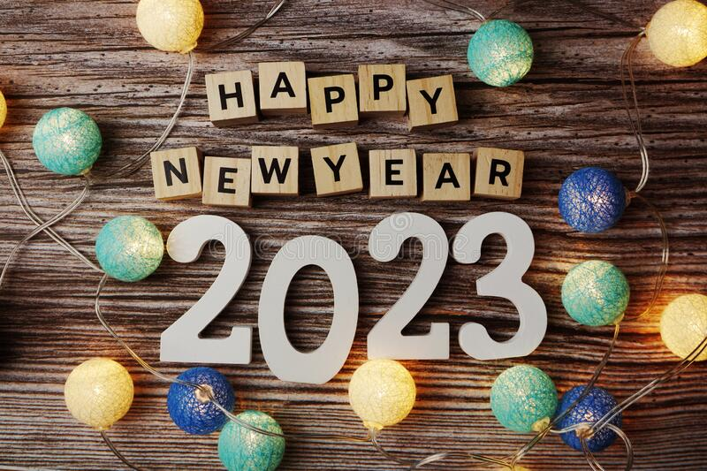

Slide 3
PREFACE
Course Lecturers:
  Dr. Kris Manohar (Kris.Manohar@sta.uwi.edu)
  Mr. Inzamam Rahaman (Inzamam.Rahaman@outlook.com)
Online Platform: myElearning + YouTube
Course times: Wednesday 17:00 – 20:00 (GMT-4)
Course Programming Language: Python (maybe some Scala too)

Slide 4
AGENDA
Course Motivation and Expectations
Overview/Summary of content schedule
Evaluation Structure
Basic introduction to big data concepts
  What is Big data?
  What is data mining?

Slide 5
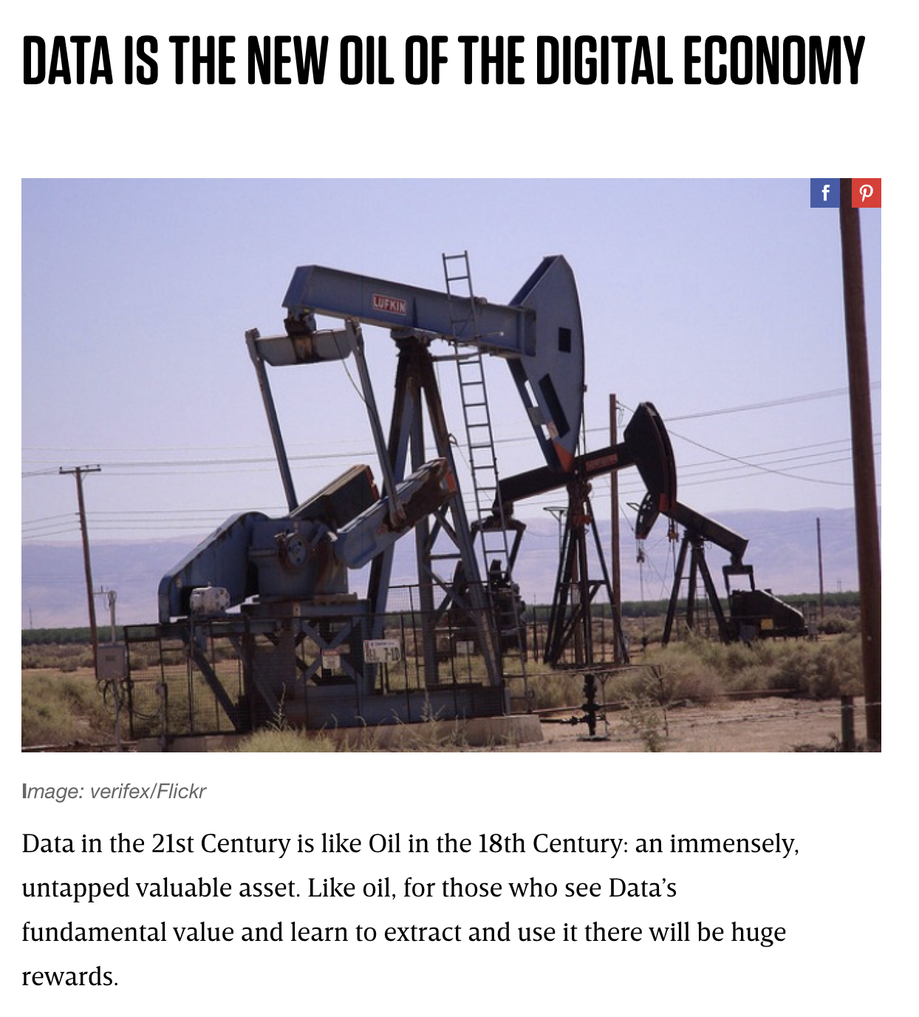
COURSE MOVITIVATION
Over 2 Petabytes of data are generated daily across the globe
  Financial transactions, tweets, social media posts, video uploads, digital traces, etc…
Data can lead to powerful and useful insights!
But first, data must be:
  Stored
  Managed
  Analyzed
  However…

Slide 6

COURSE MOVITIVATION
Extracting usable products and insights from data is difficult engineering challenge
Large volumes of data “break” some traditional assumptions
Data storytelling is difficult
Course objectives in a nutshell:
  Help equip you with key intuitions and foundational knowledge to tackle these problems

Slide 7
COURSE EXPECTATIONS
Data science is a rapidly developing field
Best approaches, essential methods, and standards are still in development
Like pinning Jell-O to a wall
We focus on core technologies/approaches to build sound foundation + give a taste of current trends/developments
Is a graduate level CS course:
Lot of self-study and research
Expect foundational programming ability (in Python)
Expect mathematical maturity of at least undergrad STEM degree

Slide 8
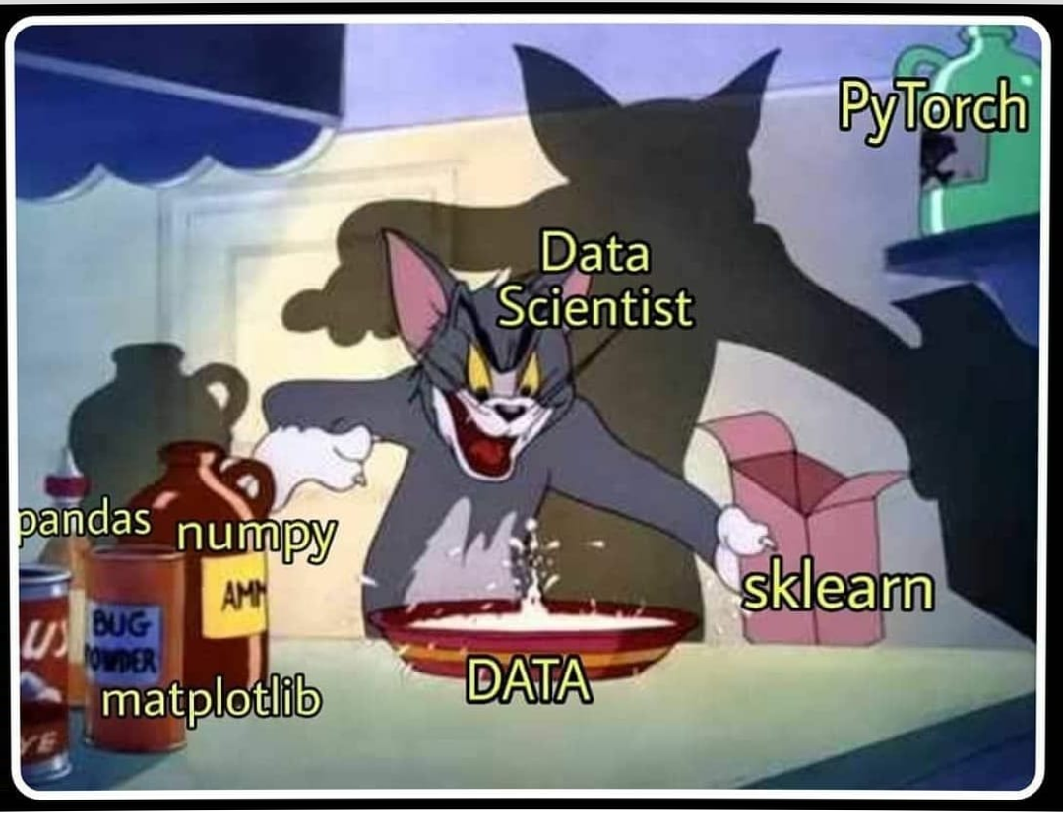
TECHNOLOGY STACK
As aforementioned, we expect you to write non-trivial programmes in Python 3.10 or above
  Suggest installing Anaconda distribution for Python
In addition, we will also cover tools such as Git
We recommend using LaTeX for reports through Overleaf
We suggest using a Unix environment for the course
  MacOS and Linux distro as already compliant
  Install WSL on Windows (recommend dual-booting with a Linux distro such as Ubuntu)
Suggest PyCharm, VS Code, or Data Grip as IDEs for the course
  Free access to PyCharm Professional and Data Grip through JetBrains student programme
  https://www.jetbrains.com/community/education/
Remember, this is a graduate level CS course, we are expecting the attendant technological maturity
Side note: slides use the Goldman Sans font (https://design.gs.com/foundation/typography/goldman-sans)

Slide 9
Data, raw and unrefined, A treasure trove, but hard to find. But with visualization as our guide, Insights come, and secrets bide. From patterns hidden deep, To trends on the surface, we'll keep. Big data's value, now clear to see, Thanks to visualization's key. It helps us make sense, Of this complex dense. And with it, we can tell a story, Of data's true worth and its glory.
- ChatGPT

Slide 10
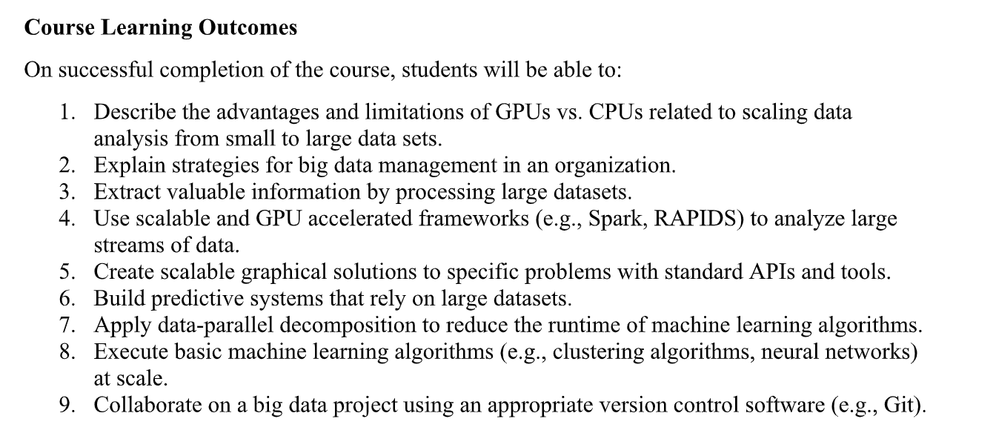

Slide 11
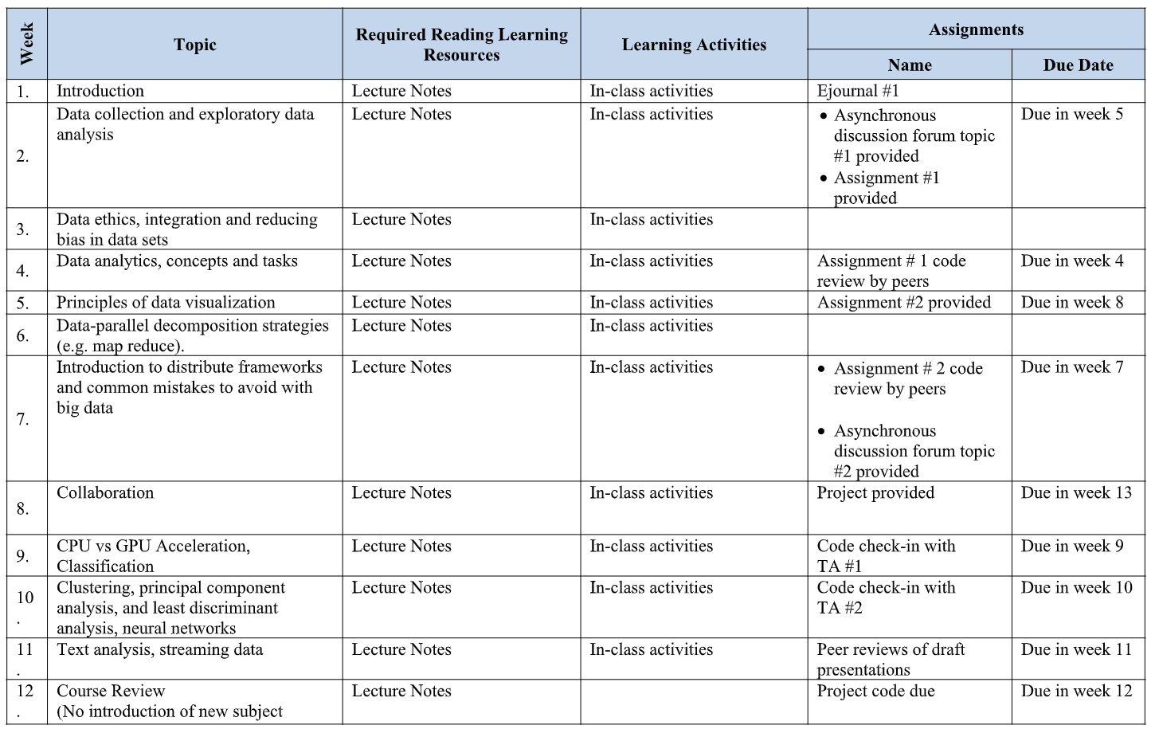

Slide 12
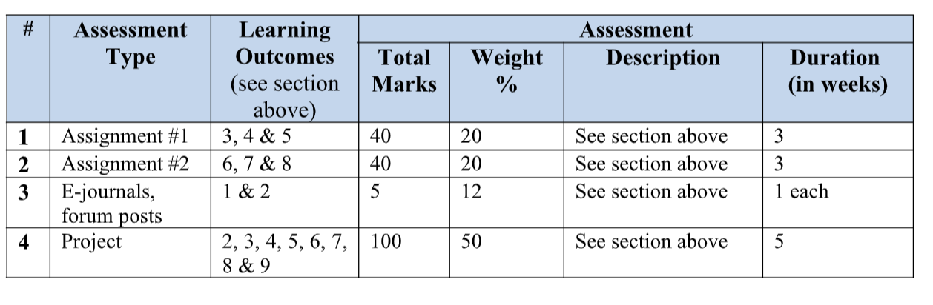

Slide 13
BIG DATA
Rate of data production across all industries and human activities is rapidly increasingly every year
Data generated from multiple sources
Rapidly accumulated is large and complex
Constellation of integrated traits emerges
  The 6 V’s of Big Data

Slide 14
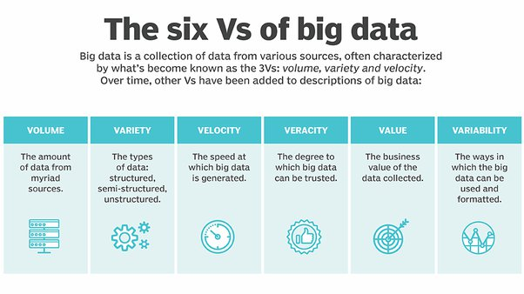

Slide 15
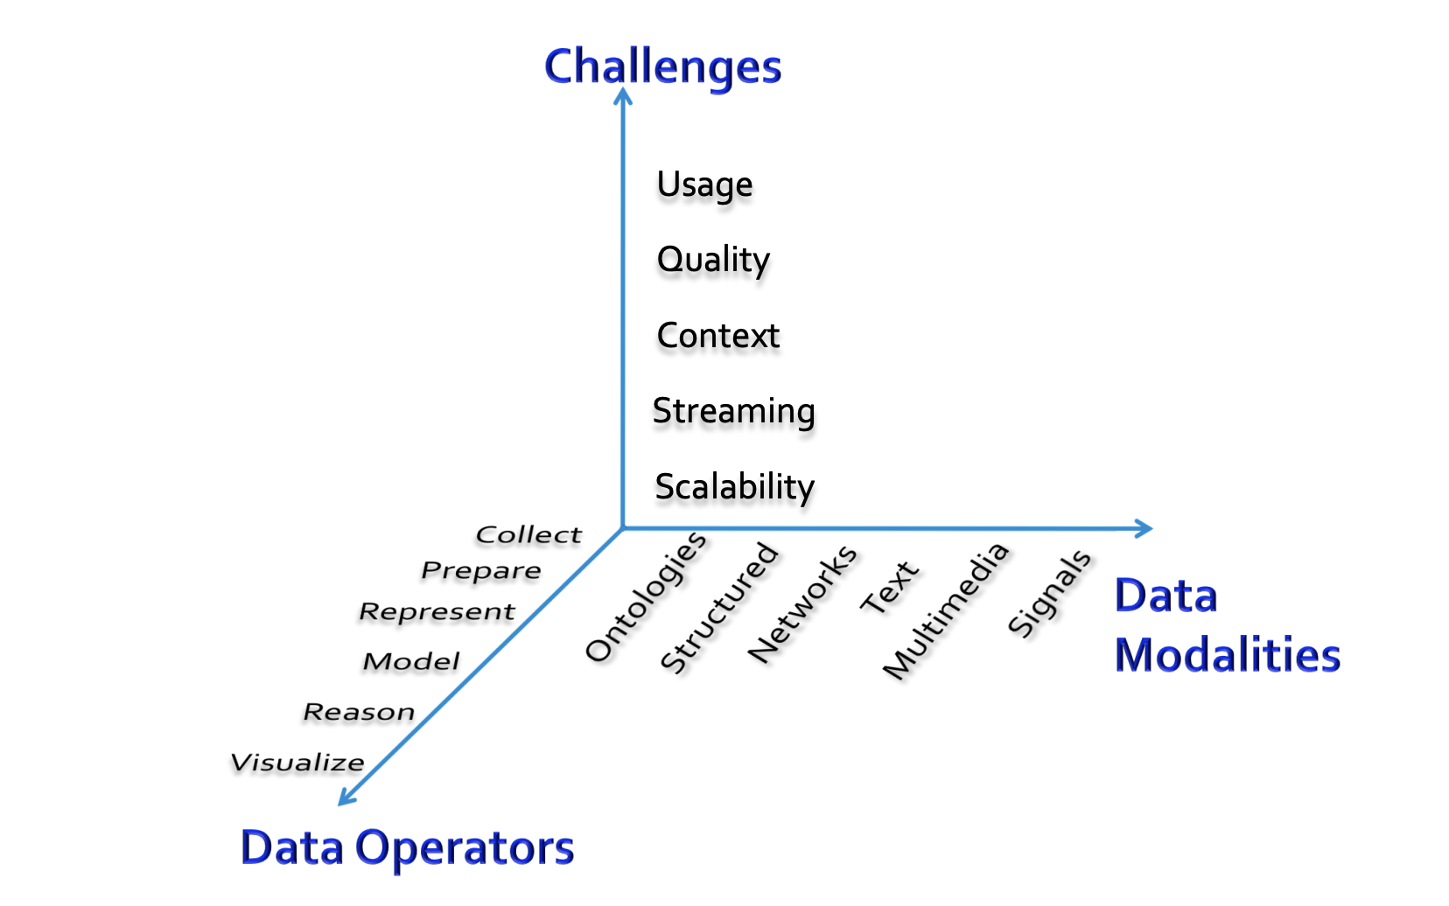
CONSIDERATIONS WHEN WORKING WITH BIG DATA

Slide 16
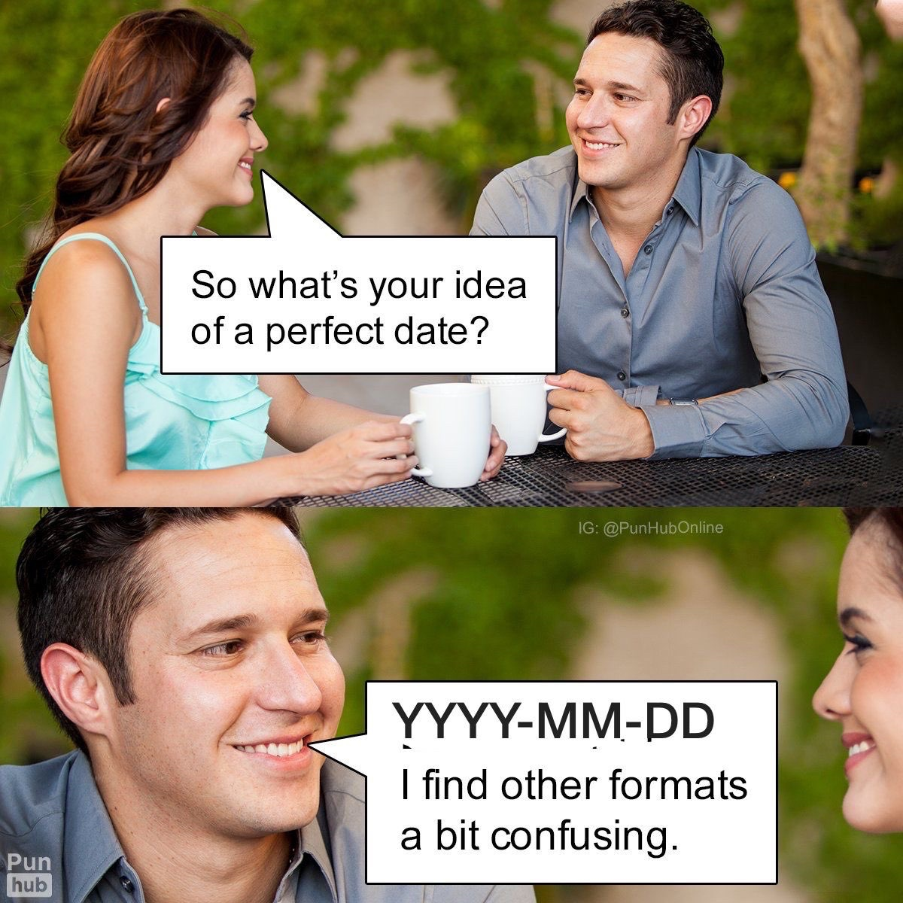
BIG DATA – DATA CLEANING
Data from source systems are almost always messy and legion with issues that hamper correct usage
Form validation didn’t exist as we know it today in the 70’s
Inconsistent and erroneous formats, e.g. DDMMYY and MMDDYY in the same data field
Would discuss more on data cleaning next lecture

Slide 17

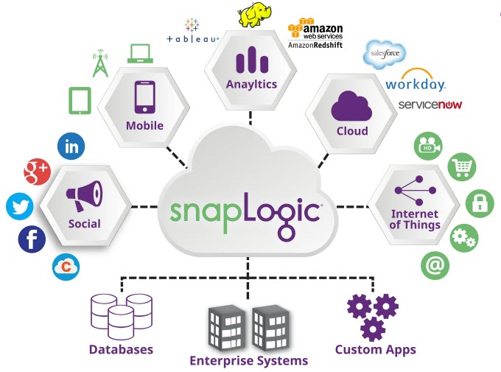
BIG DATA – ETL
Extract: data is pulled from required source systems and databases
Transform: data is cleaned and otherwise transformed from source sytems
Load: transformed data is loaded into format or storage amenable to analysis and additional processing for data mining (next slide)
  Files (e.g. Feather, CSV, etc…)
  Data Warehouses/Data Lakes (e.g. Snowflake)
Several tools for ETL (Apache Airflow, SnapLogic)
In reverse ETL, data is piped from the load area back to the source areas from which the data is extracted

Slide 18
BIG DATA – DATA MINING
Goal of data mining is to extract patterns from large quantities of data and build models that allow us to make predictions of the data
Data Mining can be split into
  Descriptive: characterize patterns in the data, e.g. clustering for customer segments, stream processing for computing live statistics
  Predictive: develop models to predict unknown or future values of some variable, e.g. predicting risk of churn, recommender systems to recommend products
At best data mining produces results that are:
  Valid: patterns and models are representative of current and future state respectively
  Useful/Actionable: possible to use descriptive or predictive insights
  Unexpected/Interesting: results are non-trivial
  Understandable/Explainable: results can be interpreted and understood by human beings
Will discuss some good practices in detail in later lectures

Slide 19
BIG DATA – DATA MINING
Suppose we want to increase sales. Number of sales would be KPI
  We want to increase this KPI
One way would be more tailored marketing strategies to most valuable segments (i.e. lever)
Data Mining can help us determine segments from dataset to support and enable business lever
Data Mining is essential tool in digital transformation
Good data science, often involves hypotheses – don’t just throw random modelling techniques at data and see what sticks

Slide 20
DATA VISUALIZATION
Results from data analysis would need to be communicated to stakeholders or fellow researchers
Data visualization is concerned with pictographically and diagrammatically representing important trends in the data
  Often with charts that represent the relationships between different quantities in the data
Good visualizations:
  Correct: correctly encode the data from the dataset
  Honest: are created without the intention of misleading the audience
  Visually appealing: should not use garish and distracting palletes or organization

Slide 21
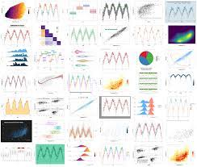


DATA VISUALIZATION
Many different chart types for data viz:
  Pie, Line, Box plot, etc….
Visualizations can be standalone or can be embedded in a dashboard to assist in decision making
Tools for creating visualizations:
  JavaScript – D3
  R – ggplot
  Python – Matplotlib, Seaborn, Plotnone (ggplot in Python)
  Dashboards – Tableu, PowerBI

Slide 22
BUILDING BLOCKS OF DATA MINING PRACTICE
Collection
Cleaning
Integration
EDA/CDA
Visualization
Modelling
Presentation/Dissemination

Slide 23
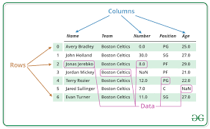
DATAFRAMES
Many datasets would be either natively tabular or can be massaged into being tabular
Most ML/DS libraries expect tabular formats
Dataframes are common abstract data type for working with data in a tabular format
Many different implementations:
  Pandas
  Polrs
  Dask
Offer:
  Data indexing
  Data selection and filtering
  Creation and update of columns
  Etc…

Slide 24
SELF DEVELOPMENT
Main scientific conferences/journals: KDD, WebConf, ICDM, IEEE BigData, ASONAM, CHI, RecSys, TKDE, etc…
TowardsDataScience: medium blog channel. Lots of great ideas – also loads of nonsense. Always read critically
Reddit – r/datascience and r/machinelearning are pretty good places to learn of new technologies and approaches

Slide 25
E-JOURNAL #1
Graphs are becoming increasingly important data structures and abstractions in data mining and big data, thereby leading to the sub-field of graph mining. Research and reflect on this trend and its implications
Due next week Friday @ 11:59 PM (AoE)

Slide 26
QUESTIONS?

Slide 27
IMAGE CREDITS
SLIDE 5: https://www.wired.com/insights/2014/07/data-new-oil-digital-economy/
SLIDE 8 & 15: r/DataScienceMemes
SLIDE 13: https://www.quora.com/What-are-the-six-Vs-of-Big-Data
SLIDE 14: http://www.mmds.org/mmds/v2.1/ch01-intro.pdf
SLIDE 16b: https://siliconangle.com/2017/02/15/snaplogic-expands-cloud-app-kafka-real-time-support-new-release/
Slide 22: https://www.geeksforgeeks.org/python-pandas-dataframe/

